Slide 1
List
Rendering

Slide 2
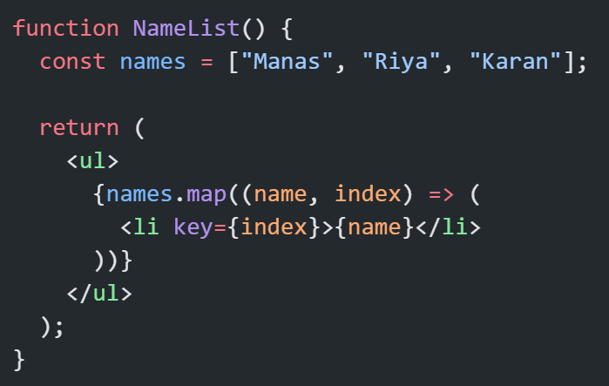
What is List Rendering?
List Rendering means displaying multiple items (like data from an array) in JSX.
we use JavaScript’s .map() method to loop through data and return JSX elements.

Slide 3
Why we use .map() in React
React works with immutable UI updates, and .map() creates a new array without modifying the original.
JSX can embed JavaScript expressions inside { }, so we can directly use array.map() in our JSX return.

Slide 4
Different Types of Arrays to Render

Slide 5
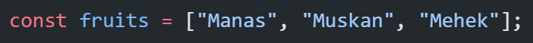
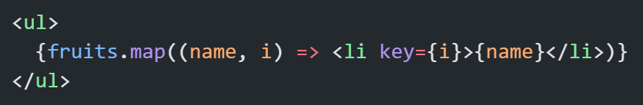
(A) Normal Array

Slide 6
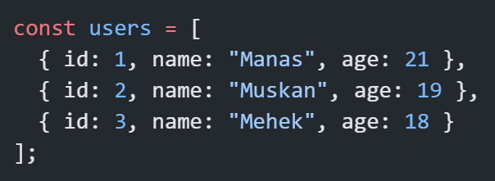
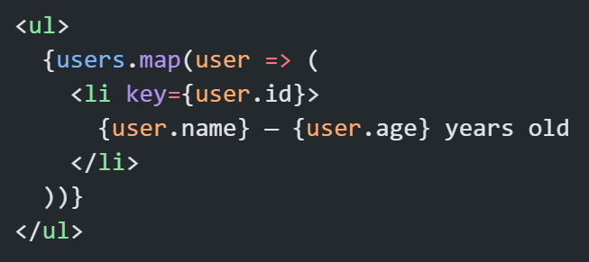
(B) Array of Objects

Slide 7
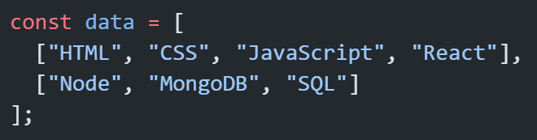
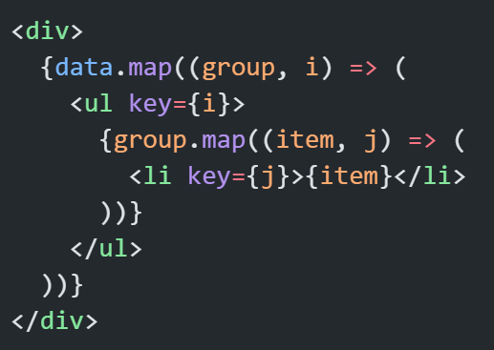
(C) Array of Arrays

Slide 8
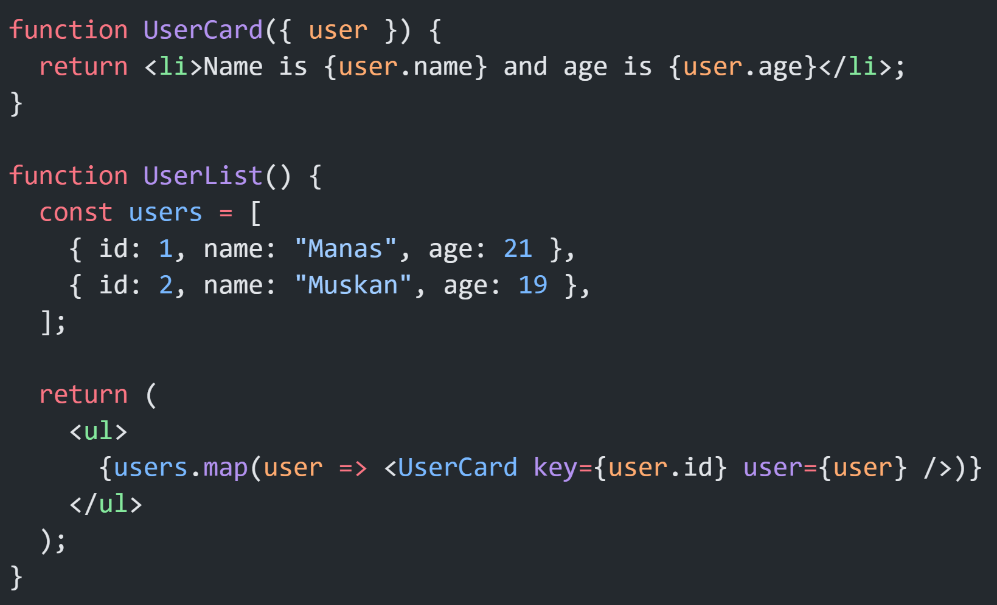
Rendering Components with .map()
Instead of inline JSX, create a reusable component.

Slide 9
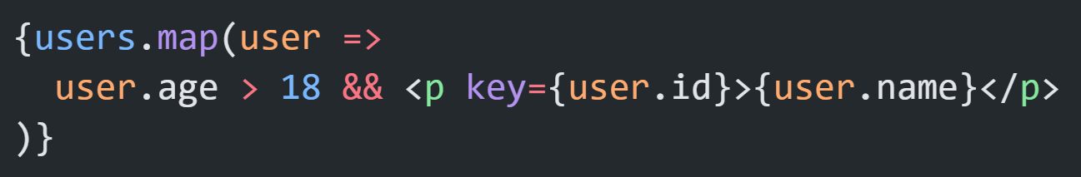
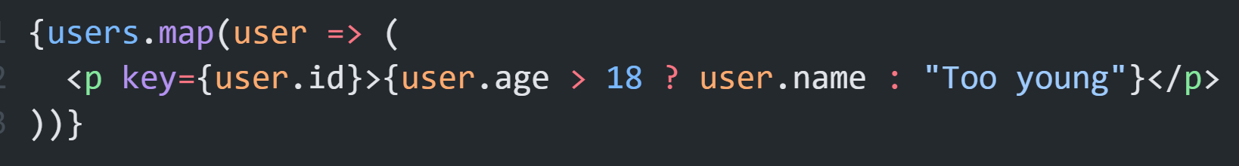
Conditional Rendering with Mapping
You can also conditionally show elements during map

Slide 10
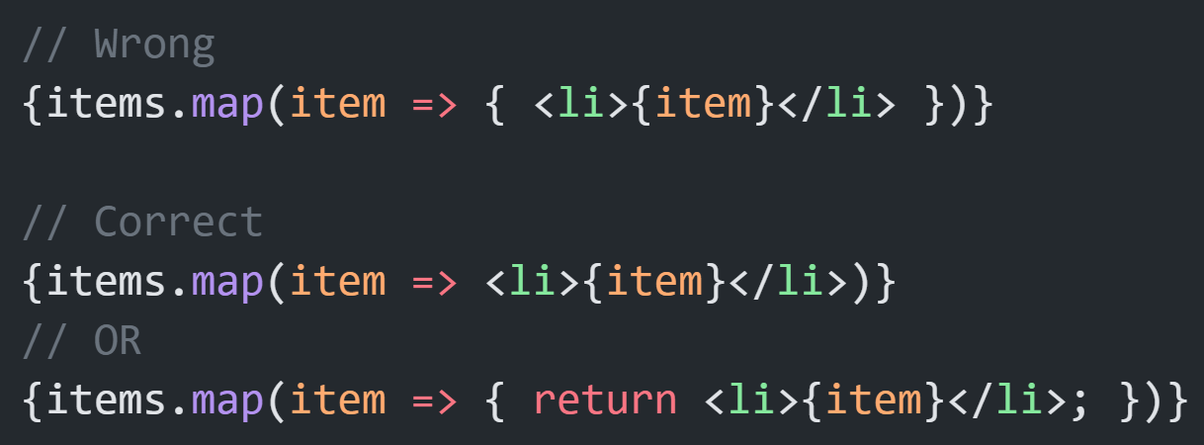
Common Beginner Mistakes
🚫 Mistake 1: Forgetting return when using curly braces in arrow function:
🚫 Mistake 2: Not using key prop.
🚫 Mistake 3: Mutating the original array before mapping.
🚫 Mistake 4: Returning multiple root elements inside .map() without wrapping (use <React.Fragment>).

Slide 11
Thank You

